Slide 1
BrainPoint
STUDY AI TOOL
Sprint 5
Created By:
Minhad Mahmud - Zaid Ansar - Muhammad Sameer - Ahmed Ahmed - Kaleb Befekadu

Slide 2
Presentation Overview
Areas we will look at:
Key Features
Technologies Used
Back-End & AI code
Current Functionality
Original features vs Near Final Product

Slide 3
Project Key Features
Key Features Include:
Study Subject Creation
Goal Setting
AI-Recommended
Data Logging and Refinement

Slide 4
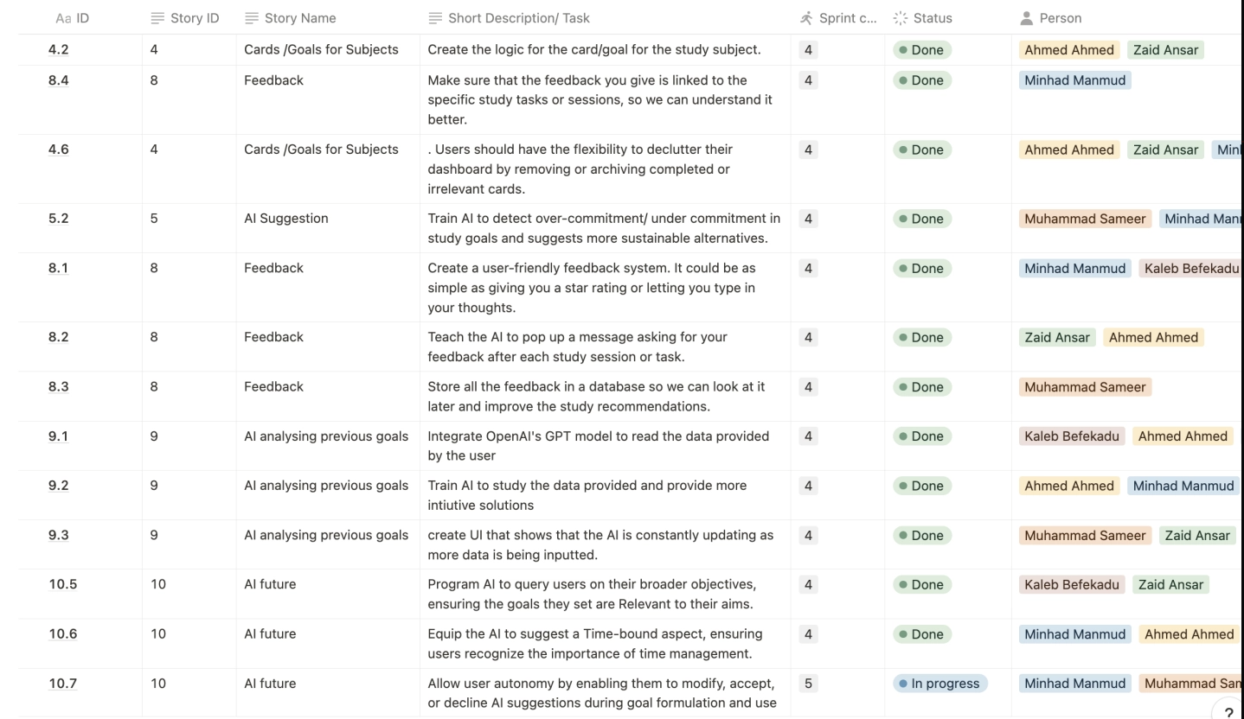
Backlog

Slide 5
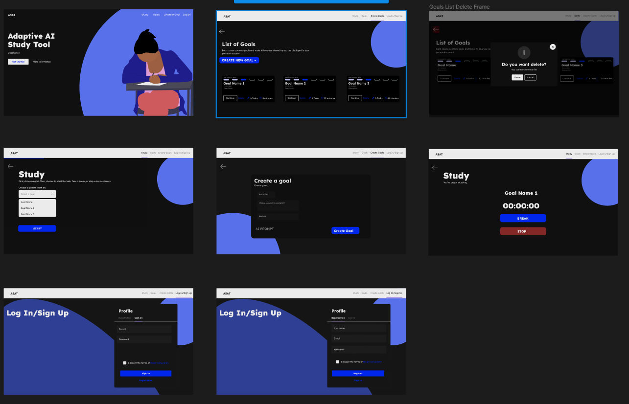
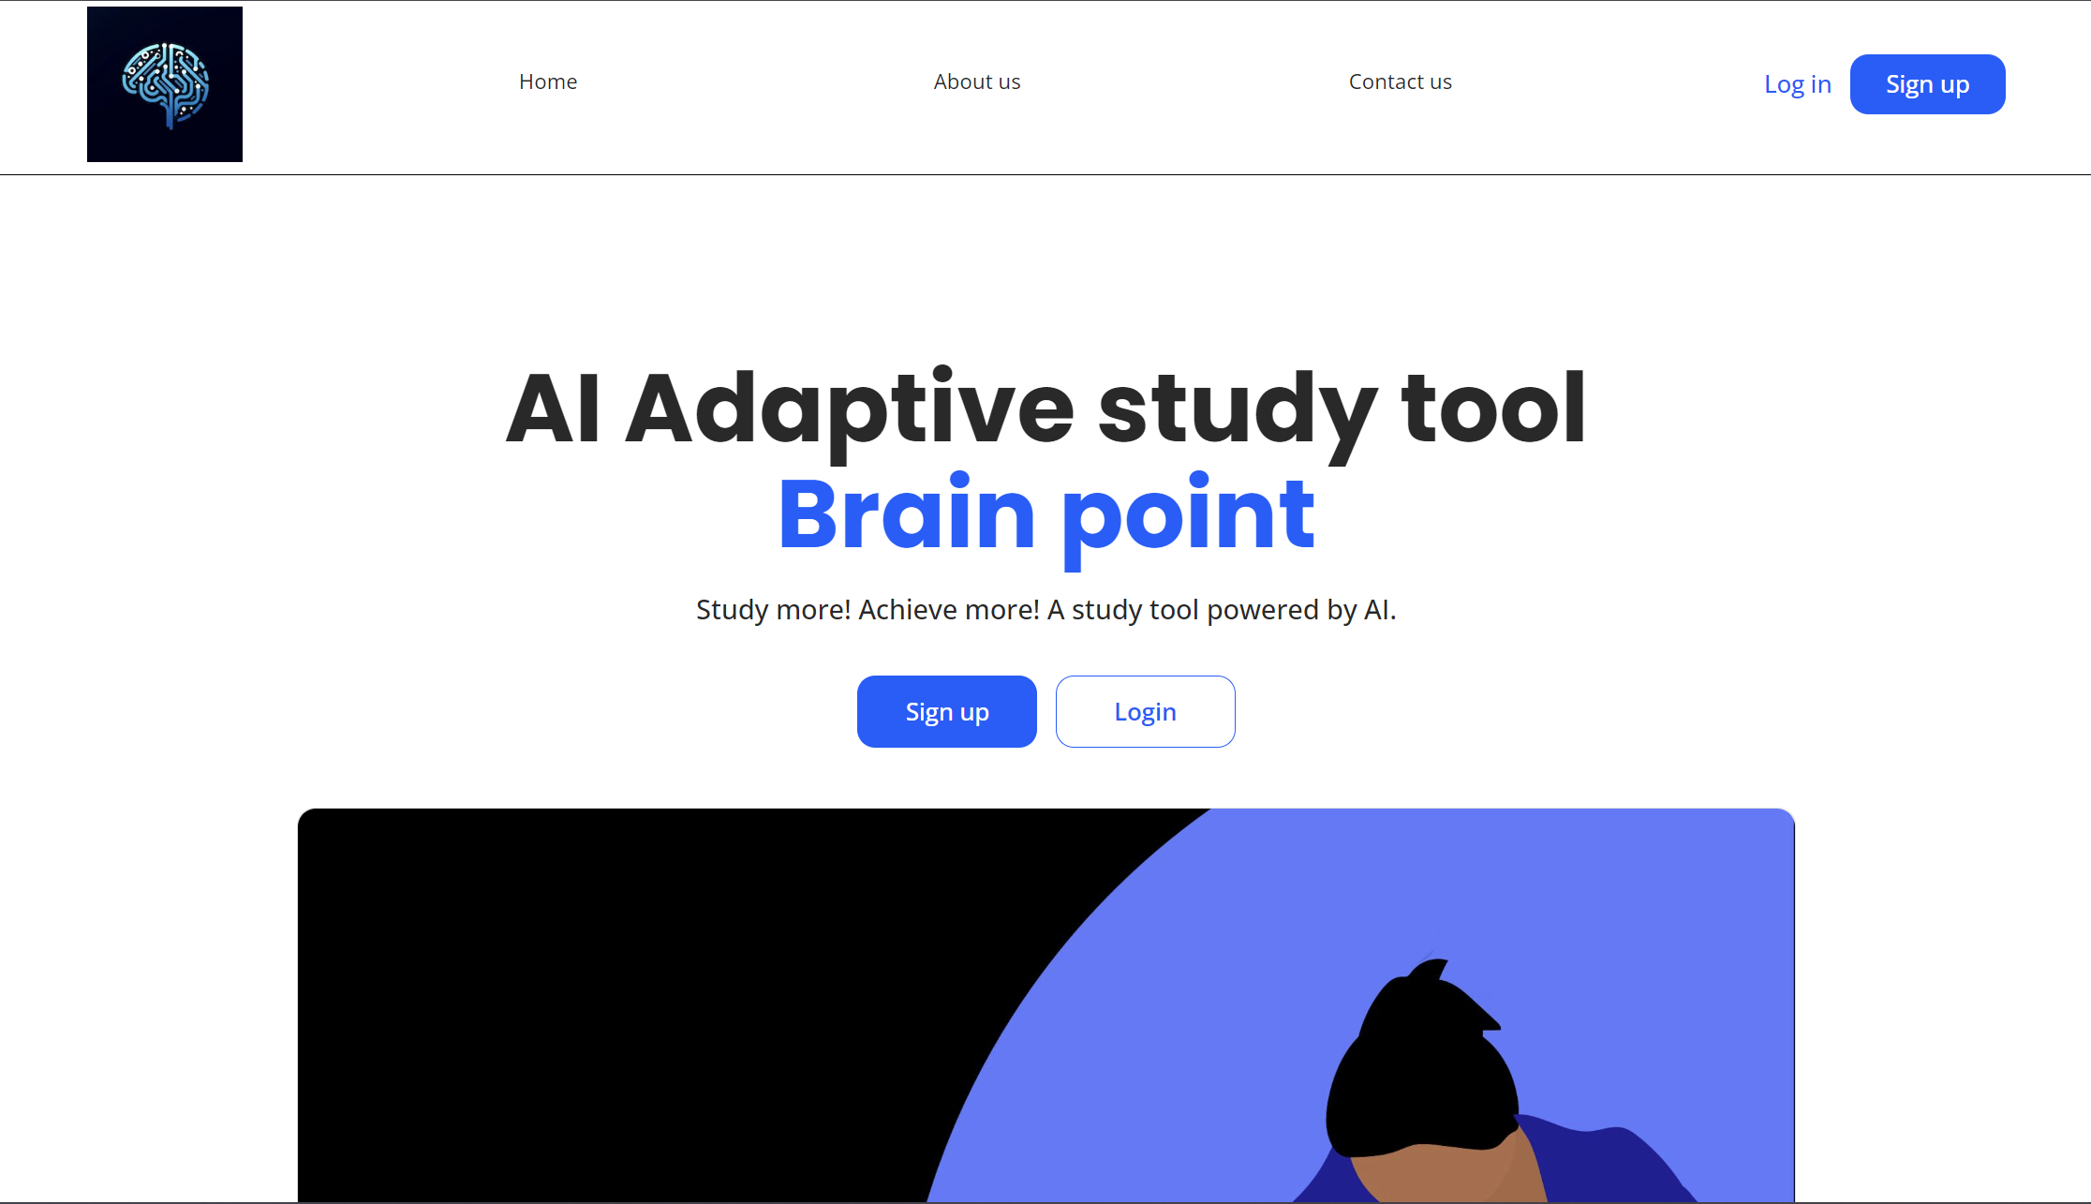
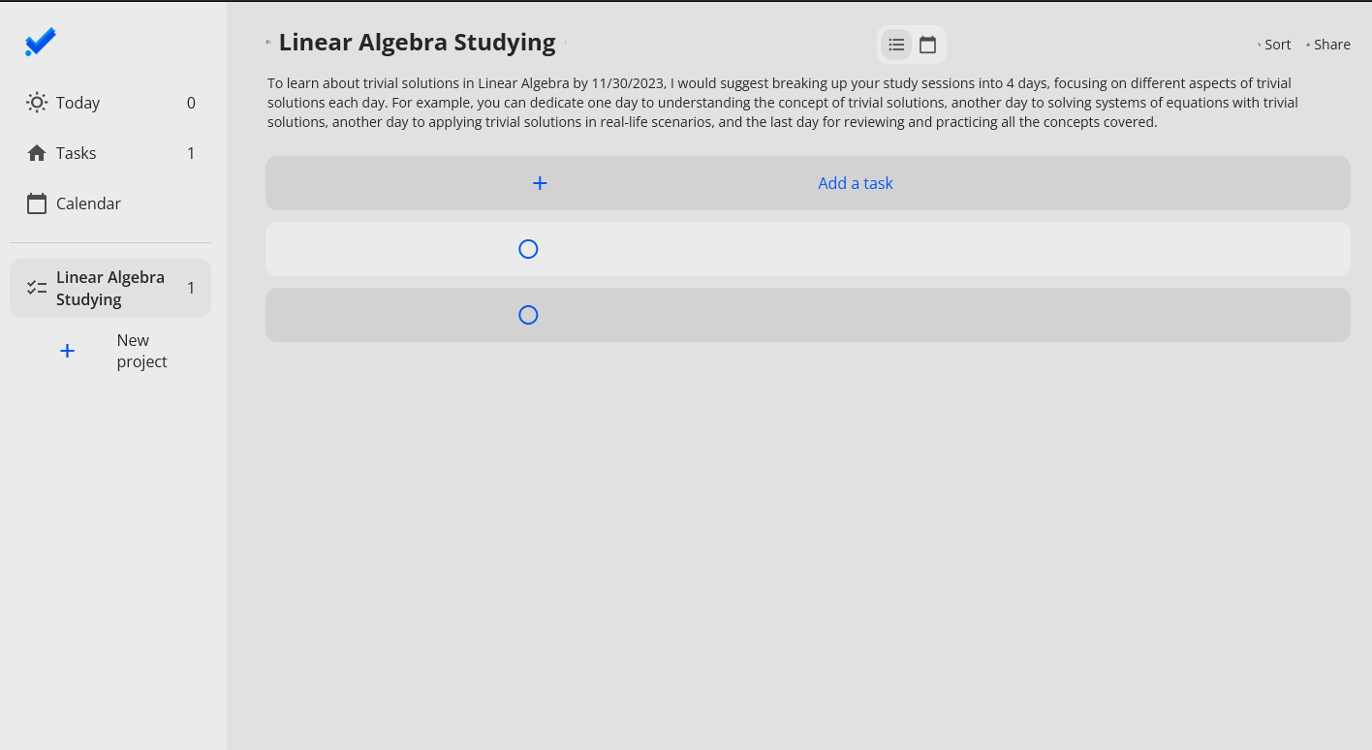
Original design vs Current product
Original Figma Interface
Nearly Finished Project using Bubble.io
Original Plan:
Use Figma for front end
Use Brainpoint for AI, Database, Google Calendar Integrations
Not used:
Some of the Figma for User Interface, settling for Bubble.io's interface tools.
Integration of Google Calendar

Slide 6
Technologies Used
Technologies intended to be used in this project included:
Client-Side Interface: Figma
Back-End Development: Bubble.io
AI Features: OpenAI API
Data base and System design done by Muhammad, Kaleb, Ahmed
Figma and Web-App Designs Primarily done by Zaid, Ahmed, & Minhad
AI Development Primarily done by: Kaleb & Muhammad

Slide 7
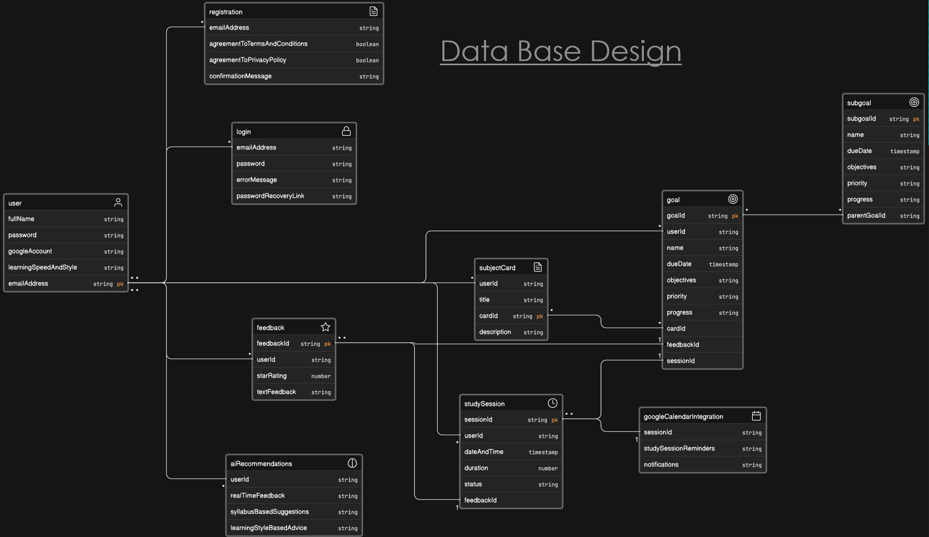
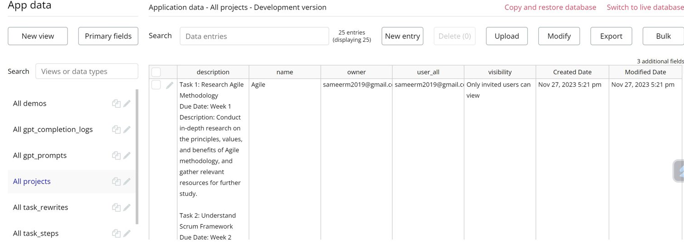
Back-End Database integration
Back-End & ChatGPT programming:
DATABASE in BUBBLE.io

Slide 8
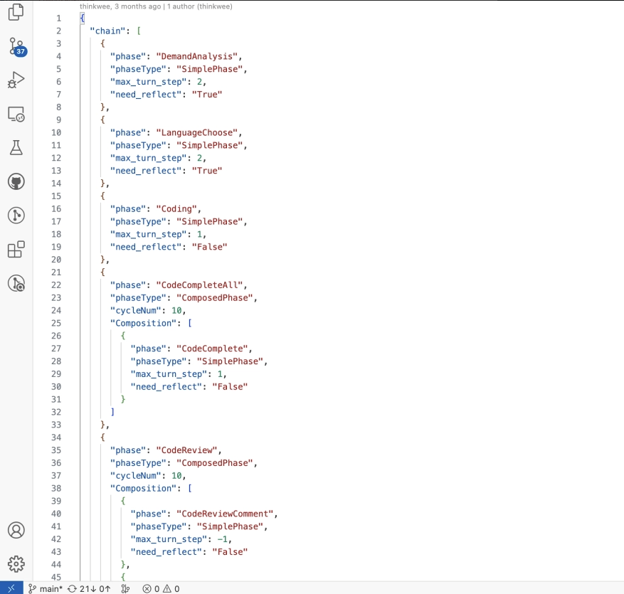
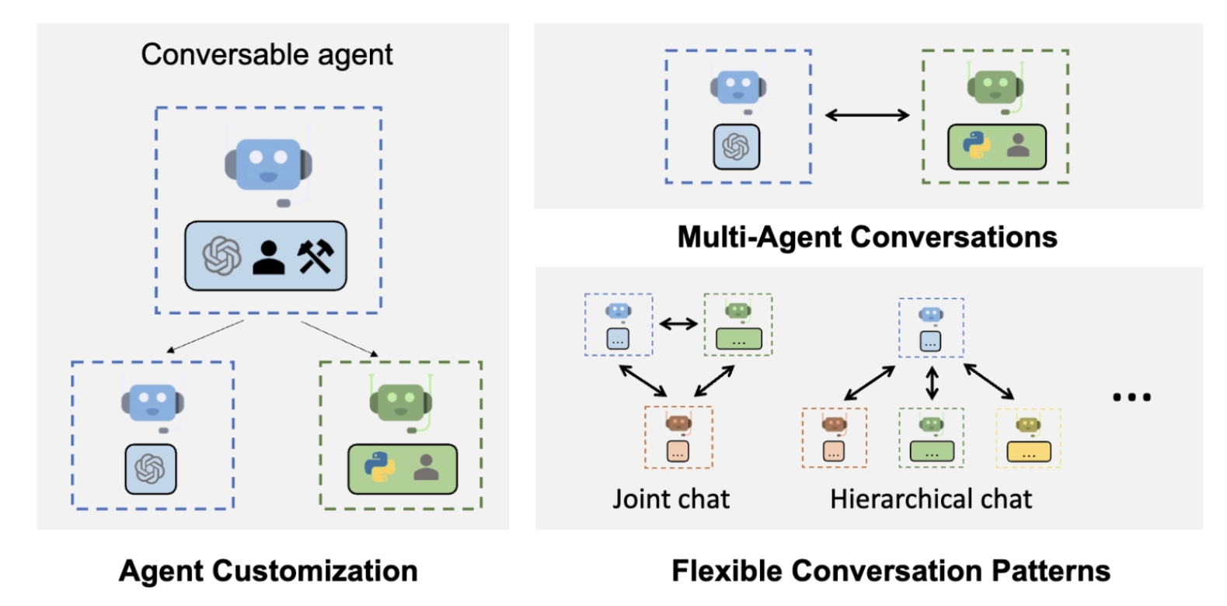
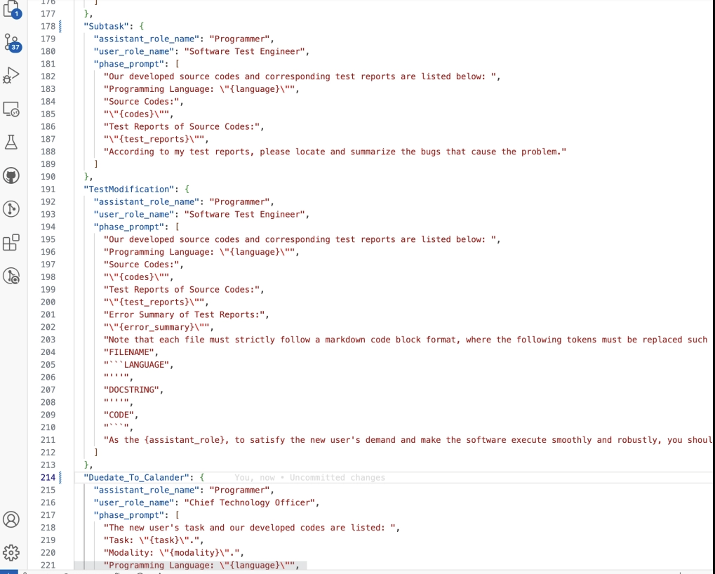
Back-End & AI integration
Back-End & ChatGPT programming:

Slide 9

Demonstration: Current Functionality
https://ai-to-do-list-76129.bubbleapps.io/version-test/
We will take a look at:
Overview of Completed Features
Demonstration of Interface
Progress in AI Integration

Slide 10
Q & A

Slide 11
Thank you Project created by: Minhad Mahmud Zaid Ansar Muhammad Sameer Ahmed Ahmed Kaleb Befekadu PowerPoint by: Zaid Ansar

